Slide 1
AMOTECH 2004
Feb. 2004
AMOTECH Co.
www.amotech.co.kr

Slide 2
Key Highlights
AMOTECH is……
AMOTECH in the Market
-. Product / Major Customers / Market Share
-. Why AMOTECH ?
Competitiveness
-. Product & Value
-. Quality & Reliability
-. Technology
Spec. of New Products
-. Ultra Low Capacitance varistor
-. Space Saved Array Varistor
-. Feed-Thru Type EMI-ESD Filter
-. R-C Type EMI- ESD Filter

Slide 3
AMOTECH is…
AMOTECH Biz. Division
AMOTECH is
built on advanced materials, the cornerstone of future industries, AMOTECH
(Advanced Materials On TECHnology) designs, develops, manufactures and
markets a broad range of high quality components and materials to serve the
telecommunications and energy conversion industries worldwide.
AMOTECH Co.
AMOS Div.
AMECS Div.
AMOTRON Div.
Amorphous Core
Ceramic Component
(Chip Varistor, RF Comp.)
BLDC Motor

Slide 4
AMOTECH is…
AMECS Division
AMECS division is our primary growth engine for the future. AMECS is fully geared
up and poised to serve the rapidly increasing demand for ceramic component technology
in the global mobile communications industry.
Multi-Layer Ceramic Chip Varistors set new performance standards for ESD
(Electro-Static Discharge) protection in hand-held electronic devices like Cell Phones
and PDA's, as do our Ceramic Microwave Components.
Chip Component
Microwave Component
Multi-Layer Chip Varistor
Dielectric Resonator
Ceramic Patch Antenna
Microwave Filter

Slide 5
Key Highlights
AMOTECH is……
AMOTECH in the Market
-. Product / Major Customers / Market Share
-. Why AMOTECH ?
Competitiveness
-. Product & Value
-. Quality & Reliability
-. Technology
Spec. of New Products
-. Ultra Low Capacitance varistor
-. Space Saved Array Varistor
-. Feed-Thru Type EMI-ESD Filter
-. R-C Type EMI- ESD Filter

Slide 6

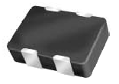
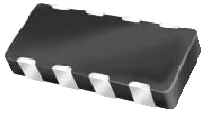
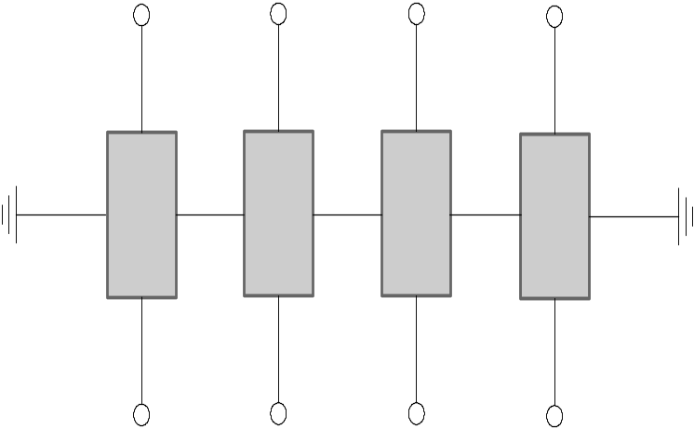
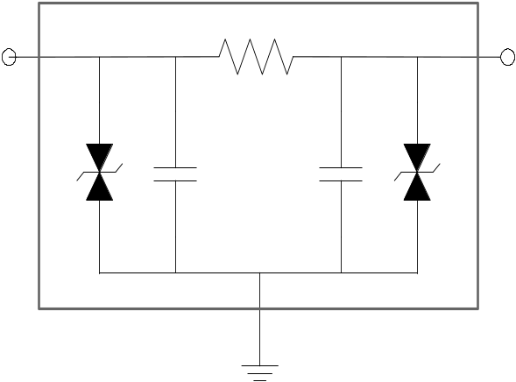
AMOTECH ESD/EMI Components
AMOTECH in the Market
ESD | Single | 2-elements | 4-elements | 8-elements
ESD + EMI
0402
ULCV(0.8 pF)
0405
0508
0405
New
0508
New
New
0508
0508
New
New

Slide 7
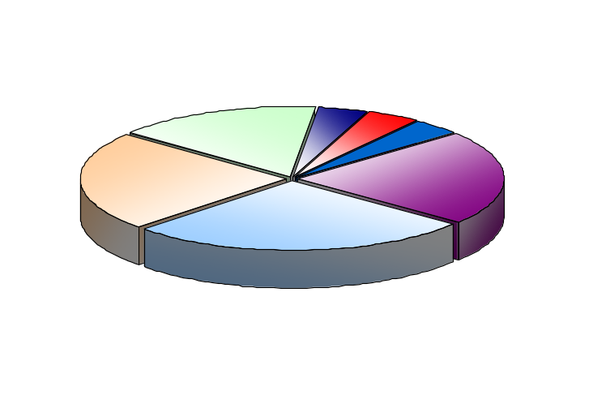
Major Customers – Mobile Phone
AMOTECH in the Market
AREA | CUSTOMER | ITEM | Monthly Volume ( pcs ) – Oct. 2003
Domestic | SAMSUNG, etc | 0402 , 0603, Array | 300 Million
Overseas |  | 0402 , 0603 | 20 Million
Total |  |  | 320 Million
Worldwide Market Share – Mobile Devices
Company ‘M’
3%
Etc.
9 %
Company ‘T’
17 %
Note) Calculating Market Share for only Hand-Held
Electronics Devices
Company ‘A’
18 %
Company ‘E’
25 %
AMOTECH
28 %

Slide 8
Why AMOTECH?
AMOTECH in the Market
Product & Value
Quality & Reliability
Technology
Full Line-up of Product
-. Single & Array types
-. Low Cap., Low Volt.
-. Dual-Functionality
: EMI-ESD Filter
High Level Capacity
-. Strength in 0402 size
-. End of 2003
Single : 300 Mil. pcs / Month
Array : 20 Mil. pcs / Month
Competitiveness
in Price & Quality
ISO 9001 QM System
-. Plan : TS16949 in 2004
-. Thorough Inspection of 90
items throughout process
Tighter Standards for Reliability
than those of others
-. Stable Quality even after
20K of ESD Strikes
-. Very Low Leakage Current
-. Top-Tier Supplier
by Samsung Electronics.
Know-How in Product Design
-. for ESD and ESD+EMI
-. the smallest component
Process Technology
-. Green Sheet with 5 micro-
meter thickness.
Technology in Formula
& Micro-Structure Control
-. Ceramic & Electrode materials

Slide 9
Key Highlights
AMOTECH is……
AMOTECH in the Market
-. Product / Major Customers / Market Share
-. Why AMOTECH ?
Competitiveness
-. Product & Value
-. Quality & Reliability
-. Technology
Spec. of New Products
-. Ultra Low Capacitance varistor
-. Space Saved Array Varistor
-. Feed-Thru Type EMI-ESD Filter
-. R-C Type EMI- ESD Filter

Slide 10
Competitiveness
- Product & Value
Product Line-up
AMOTECH’S new products line-up of varistors, ranging from ultra low cap single type to array which has EMI filter effect with various capacitance value, can offer total solutions for ESD/ EMI protection in mobile phone.
Single type : 0402 size
Array type : 2-Array, 0405 (2 of 0402)
4-Array, 0508 (4 of 0402)
0405 (4 of 0201)
8-Array, 0508 (8 of 0201)
Low Capacitance Series (3 pF ~ 100 pF)
Ultra low Capacitance ( Typ. 0.8 pF )
Effectiveness in ESD/ EMI Protection
For effective design
For high data trans. rate
For EMI sensitive ICs
For sensitive Signal intensity
ESD Filter Series with EMI filter effect.
Feed-thru type EMI
Ignorable attenuation value in ULCV

Slide 11
Competitiveness
- Product & Value
Small Size & Functionality
Strength in the small size varistor
AMOTECH Strategy
Array Type Varistor
2-elements 0405 Size
4-elements 0405, 0508 Size
8-elements 0508 size
Single Type Varistor
0402 Size
Dual Functionality
(ESD + EMI Filter)
0508 Size
R-C & Feed Thru Type

Slide 12
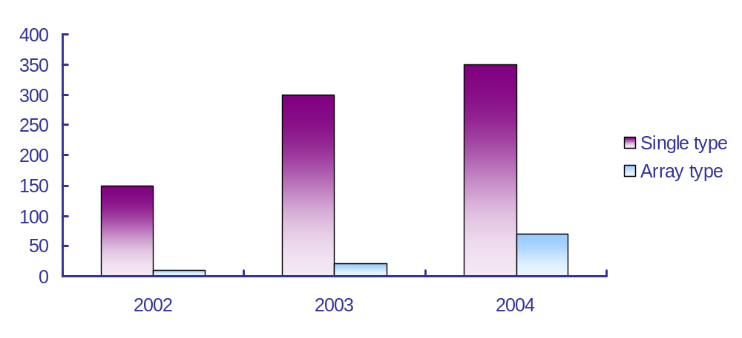
Competitiveness
- Product & Value
High Level Capacity
 |  | 2002 | 2003 | 2004
Capacity (Mil. pcs / month), end of year
Single type |  | 150 | 300 | 350
Array type |  | 10 | 20 | 70
AMOTECH Capacity Plan

Slide 13
Competitiveness
- Product & Value
Cost Reduction Strategy
AMOTECH has been exerting every possible efforts to maximize price competitiveness by focusing three major aspects and gotten concrete results that have made AMOTECH one of the leading suppliers in the world.
Material Costs
Decreasing contents of precious metals in electrodes
Productivity
Increasing productivity
Functionality
Increasing functionality
: Dual Functionality of ESD + EMI
: 4 & 8-elements array varistor of 0201 size single one
: Ultra Low Capacitance Varistor
Adding new value on varistor

Slide 14
Key Highlights
AMOTECH is……
AMOTECH in the Market
-. Product / Major Customers / Market Share
-. Why AMOTECH ?
Competitiveness
-. Product & Value
-. Quality & Reliability
-. Technology
Spec. of New Products
-. Ultra Low Capacitance varistor
-. Space Saved Array Varistor
-. Feed-Thru Type EMI-ESD Filter
-. R-C Type EMI- ESD Filter

Slide 15
Competitiveness
- Quality & Reliability
Quality & Reliability
1. High Insulation Resistance that guarantee very low leakage current
-. Through unique glass-coating process
IR of AMOTECH Varistor
> 10 mega-Ohm
After soldering
Leakage Current
< 2 micro-Amp
*) Patent Pending, USA No. 09/839 492
Japan No. 2001-149313

Slide 16
Competitiveness
- Quality & Reliability
Quality & Reliability
2. Tighter Standards for Reliability Test
Test Item | Standard^{*)}
 | AMOTECH | Competitors
DCBT(85C) test for 1000 hr with rated line voltage applied | under 5% | under 10%
HHHT(65C, 95%RH) test for 1000 hr with rated line voltage applied | under 5% | under 10%
Pressurized High Temperature Test (126C, 2 atm. 100%RH) for 24hr | under 5% | N/A
*) ΔV_{n} / V_{n} : the amount of variation of Vn ( Varistor Voltage after each test )

Slide 17
Key Highlights
AMOTECH is……
AMOTECH in the Market
-. Product / Major Customers / Market Share
-. Why AMOTECH ?
Competitiveness
-. Product & Value
-. Quality & Reliability
-. Technology
Spec. of New Products
-. Ultra Low Capacitance varistor
-. Space Saved Array Varistor
-. Feed-Thru Type EMI-ESD Filter
-. R-C Type EMI- ESD Filter

Slide 18
Competitiveness
- Technology
AMOTECH Product Road Map
Functionality
Miniaturizaion
Array
-. Feed-thru Varistor
-. ESD-Filter
(ESD+EMI)
Multi-functionality
Dual-Function (ESD + EMI)
Specialization
Array
(4 or 8) of 0201
Array
(2 or 4) of 0402 & 0603
0201
Chip Size
0603, 0805
ESD
Varistor
0402
0402
(3pF, 3V )
0402
(0.8pF)
High Energy Varistor
for Automobile
1998
2000
2002
2003
Design Flexibility
(Downsizing)

Slide 19
Competitiveness
- Technology
Technology Road Map
Our development goal can be summarized in simple words : Maximizing Competitive Edge in Value & Product
AMOTECH has set core technologies to achieve this goal and already gotten good results from unceasing effort.
AMOTECH
Core Technology
2001
2002
2003
Formula Control
Multi-Layer Formula for ESD, EMI
-. Ceramic & Electrode
Multi-Material, Multi-Layer Formula for dual function components.
Process
-. Tape Forming
Thick. : 27 um, Toler. : 1 um
Thick. : 5 um, Toler. : < 2%, For smaller Comp.
-. Fine Circuit Forming
2-Dimensional, Low Resolution
3-Dimensional, High Resolution for Smaller Modules
-. Micro-Structure Control
For Increasing Productivity & Reliability
Different Material Boundary, For Multi-Material Comp.
Design
-. Product Design
Products for Single Purpose
Multi-Functional Products & Module

Slide 20
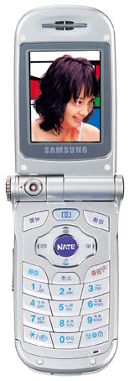
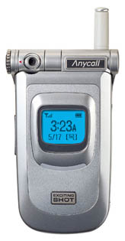
Competitiveness
- Technology
Components for Cell Phone
Current
Under Development
Multi-Layer Chip Varistor
for ESD Protection
Wide Band Chip Antenna
& Diplexer
( GPS ~ USPCS)
4-elements ESD filter
(ESD + EMI)
GPS Magnetic Sensor
Bluetooth Antenna
GPS Antenna

Slide 21
Key Highlights
AMOTECH is……
AMOTECH in the Market
-. Product / Major Customers / Market Share
-. Why AMOTECH ?
Competitiveness
-. Product & Value
-. Quality & Reliability
-. Technology
Spec. of New Products
-. Ultra Low Capacitance varistor
-. Space Saved Array Varistor
-. Feed-Thru Type EMI-ESD Filter
-. R-C Type EMI- ESD Filter

Slide 22
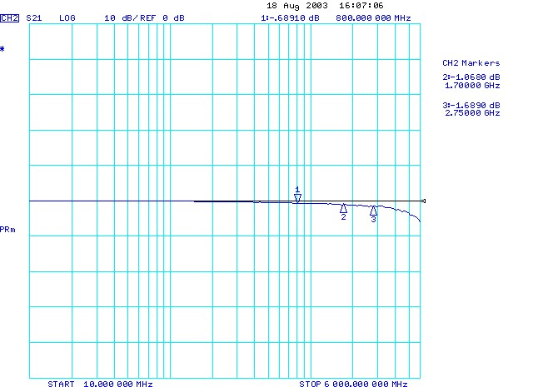
Spec. of new products
Ultra Low Cp Varistor
1. Attenuation property of ULCV- AVLC 18S 02 001
Without ULC Varistor
Frequency | Attenuation
0.8 GHz | -0.66 dB
1.7 GHz | -0.92 dB
2.75 GHz | -1.42 dB
800MHz
1.7 GHz
2.75 GHz
With ULC Varistor
Frequency | Attenuation
0.8 GHz | -0.69 dB
1.7 GHz | -1.06 dB
2.75 GHz | -1.69 dB

Slide 23
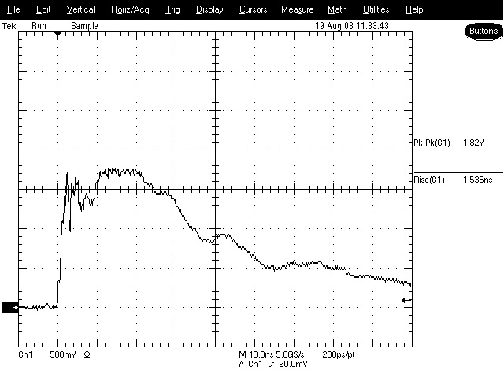
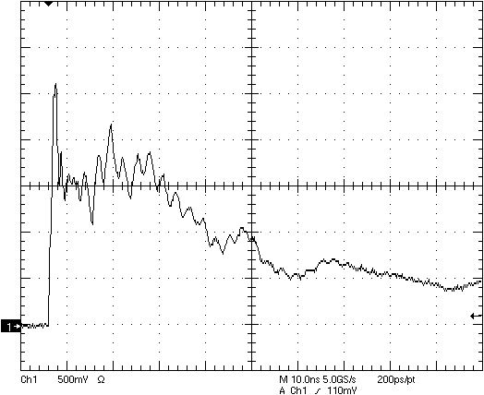
Spec. of new products
Ultra Low Cp Varistor
2. ESD Protection Effect – AVLC 18S 02 001
Without ULC Varistor
With ULC Varistor

Slide 24
Key Highlights
AMOTECH is……
AMOTECH in the Market
-. Product / Major Customers / Market Share
-. Why AMOTECH ?
Competitiveness
-. Product & Value
-. Quality & Reliability
-. Technology
Spec. of New Products
-. Ultra Low Capacitance varistor
-. Space Saved Array Varistor
-. Feed-Thru Type EMI-ESD Filter
-. R-C Type EMI- ESD Filter

Slide 25
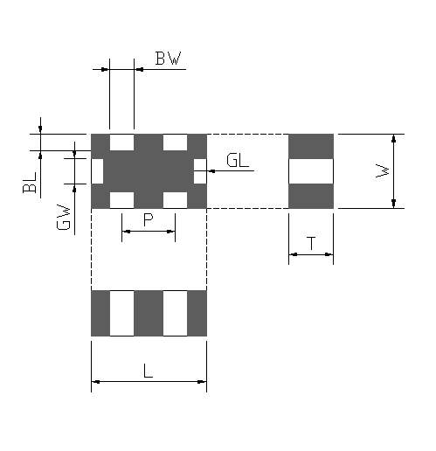
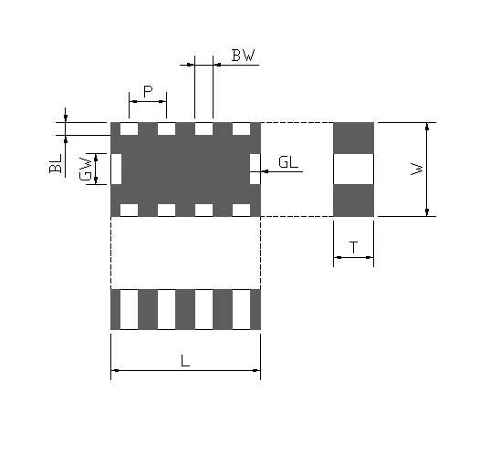
Spec. of new products
Space Saved Array Varistor
1. Dimension – AVSC 5S 04F 050 & AVSC 5S 05E 050
① 0405 = 4 elements of 0201 size
② 0508 = 8 elements of 0201 size
Class | L | W | T | P | BW | BL | GW | GL
① | 1.40±0.15 | 0.90±0.15 | 0.55 (max 0.70) | 0.65±0.05 | 0.30±0.05 | 0.20±0.10 | 0.30±0.05 | 0.15±0.10
② | 2.05±0.20 | 1.25±0.20 | 0.55 (max 0.70) | 0.51±0.05 | 0.25±0.05 | 0.18±0.10 | 0.43±0.05 | 0.15±0.10

Slide 26
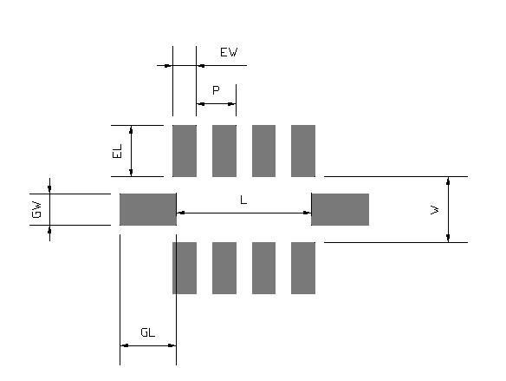
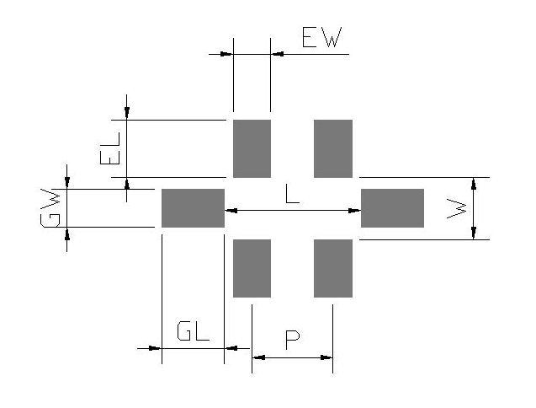
Spec. of new products
Space Saved Array Varistor
2. Recommended Land Pattern - AVSC 5S 04F 050 & AVSC 5S 05E 050
① 0405 = 4 elements of 0201 size
② 0508 = 8 elements of 0201 size
 | L | W | P | EW | EL | GW | GL
① | 1.10 | 0.50 | 0.65 | 0.30 | 0.46 | 0.30 | 0.70
② | 1.74 | 0.84 | 0.51 | 0.30 | 0.66 | 0.40 | 0.73

Slide 27
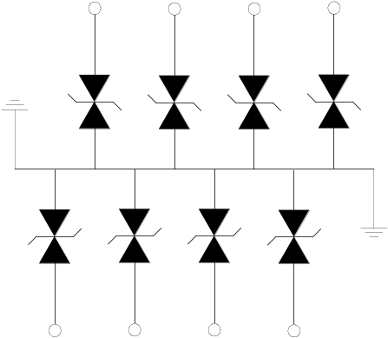
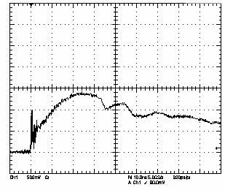
Spec. of new products
Space Saved Array Varistor
3. Equivalent Circuit & ESD protection effect
① 0405 = 4 elements of 0201 size
② 0508 = 8 elements of 0201 size
③ ESD Protection Effect

Slide 28
Spec. of new products
Specification of New Varistor
4. Electrical Properties of New Varistor
Item | Model | V_{DC} | V_{N} | V_{C} | I_{C} | I_{MAX} _{(µA)} | W_{MAX} _{(Joules)} | Cap. (pF) |  | IR (MΩ)
 |  |  |  |  |  |  |  | Max | Typ
Ultra Low Cap Varistor | AVLC 18S 02 001 | 18 | 60~80 | 200 | 1.0 | 0.8 | 0.005 | 1 | 0.8 | 10
4-elements varistor (0405 Size) | AVSC 18S 04 F 010 | 18 | 22 | 45 | 1.0 | 5 | 0.005 | 10 | 8 | 10
 | AVSC 5S 04 F 025 | 5.5 | 8 | 25 | 1.0 | 10 | 0.03 |  | 25 | 10
 | AVSC 5S 04 F 050 | 5.5 | 8 | 25 | 1.0 | 10 | 0.03 |  | 50 | 10
8-elements varistor (0508 Size) | AVSC 18S 05 E 010 | 18 | 22 | 45 | 1.0 | 5 | 0.005 | 10 | 8 | 10
 | AVSC 5S 05 E 025 | 5.5 | 8 | 25 | 1.0 | 10 | 0.03 |  | 25 | 10
 | AVSC 5S 05 E 050 | 5.5 | 8 | 25 | 1.0 | 10 | 0.03 |  | 50 | 10

Slide 29
Key Highlights
AMOTECH is……
AMOTECH in the Market
-. Product / Major Customers / Market Share
-. Why AMOTECH ?
Competitiveness
-. Product & Value
-. Quality & Reliability
-. Technology
Spec. of New Products
-. Ultra Low Capacitance varistor
-. Space Saved Array Varistor
-. Feed-Thru Type EMI-ESD Filter
-. R-C Type EMI- ESD Filter

Slide 30
Spec. of new products
Feed-thru Type EMI-ESD Filter
1. Dimension & Recommended Land Pattern
Class | L | W | T | P | BW | BL | GW | GL
size | 2.05±0.15 | 1.25±0.15 | 0.55±0.15 | 0.50±0.05 | 0.25±0.10 | 0.25±0.10 | 0.40±0.10 | 0.25±0.10
 | L | W | T | P | EW | EL | GW | GL
Land pattern | 1.74 | 0.84 | - | 0.51 | 0.30 | 0.66 | 0.40 | 0.73

Slide 31
Spec. of new products
Feed-thru Type EMI-ESD Filter
2. Equivalent Circuit
of single component
of 4-elements array

Slide 32
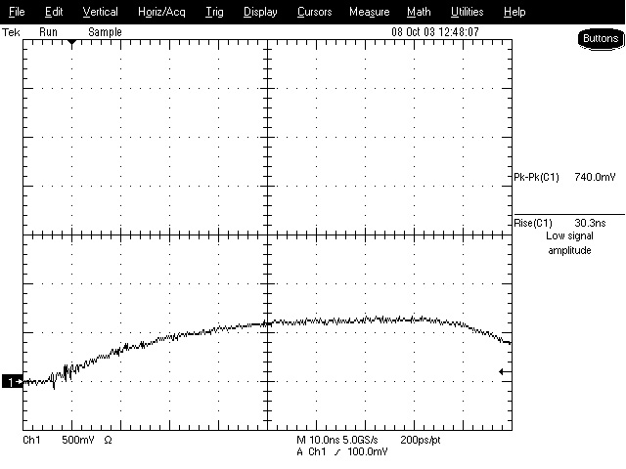
Spec. of new products
Feed-thru Type EMI-ESD Filter
3. ESD Protection Effect – AVFC 5S 05Q 050
Without Feed-thru Type Filter
With Feed-thru Type Filter

Slide 33
Spec. of new products
Feed-thru Type EMI-ESD Filter
4. EMI Filtering Effect – AVFC 5S 05Q 050
0
-10
-20
IL(dB)
-30
5S05Q100
5S05Q050
-40
14S05Q030
18S05Q010
-50
10
100
1000
5000
Frequency (MHz)

Slide 34
Key Highlights
AMOTECH is……
AMOTECH in the Market
-. Product / Major Customers / Market Share
-. Why AMOTECH ?
Competitiveness
-. Product & Value
-. Quality & Reliability
-. Technology
Spec. of New Products
-. Ultra Low Capacitance varistor
-. Space Saved Array Varistor
-. Feed-Thru Type EMI-ESD Filter
-. R-C Type EMI- ESD Filter

Slide 35
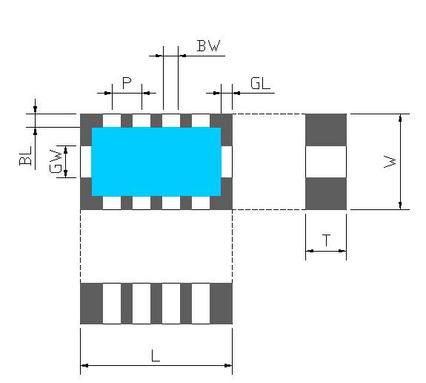
Spec. of new products
R-C Type EMI-ESD Filter
1. Dimension & Recommended Land Pattern
Class | L | W | T | P | BW | BL | GW | GL
size | 2.05±0.15 | 1.25±0.15 | 0.55±0.15 | 0.50±0.05 | 0.25±0.10 | 0.25±0.10 | 0.40±0.10 | 0.10±0.10
 | L | W | T | P | EW | EL | GW | GL
Land pattern | 1.74 | 0.84 | - | 0.40 | 0.25 | 0.66 | 0.40 | 0.73

Slide 36
Spec. of new products
R-C Type EMI-ESD Filter
2. Equivalent Circuit
of single component
of 4-elements array

Slide 37
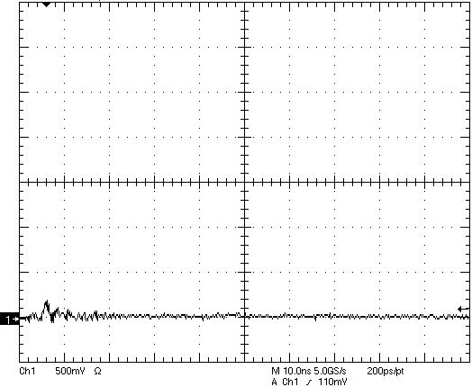
Spec. of new products
R-C Type EMI-ESD Filter
3. ESD Protection Effect
Without R-C Type Filter
With R-C Type Filter

Slide 38
Spec. of new products
R-C Type EMI-ESD Filter
4. EMI Filtering Effect
0
-10
-20
IL (dB)
-30
5S 05Q 100 100R
5S 05Q 050 100R
-40
14S 05Q 030 100R
18S 05Q 010 100R
-50
10
100
1000
3000
Frequency (MHz)

Slide 39
Spec. of new products
Specification of New EMI-ESD Filter
5. Electrical Properties of New Varistor
Item | Model | V_{DC} | V_{N} | V_{C} | I_{C} | I_{MAX} _{(µA)} | W_{MAX} _{(Joules)} | Cap. (pF) |  | IR (MΩ) | R
 |  |  |  |  |  |  |  | Max | Typ
Feed-thru Type EMI-ESD Filter (0508 size) | AVFC 18S 05 Q 010 | 18 | 22 | 45 | 1.0 | 5 | 0.005 | 10 | 8 | 10
 | AVFC 14S 05 Q 030 | 14 | 18 | 40 | 1.0 | 5 | 0.005 |  | 30 | 10
 | AVFC 5S 05 Q 050 | 5.5 | 8 | 25 | 1.0 | 10 | 0.03 |  | 50 | 10
 | AVFC 5S 05 Q 100 | 5.5 | 8 | 25 | 1.0 | 10 | 0.03 |  | 100 | 10
R-C Type EMI-ESD Filter (0508 size) | AVRC 18S 05 Q 010 100R | 18 | 22 | 45 | 1.0 | 5 | 0.005 | 5 | 4 | 10 | 100Ω
 | AVRC 14S 05 Q 030 100R | 14 | 18 | 40 | 1.0 | 5 | 0.005 |  | 15 | 10 | 100Ω
 | AVRC 5S 05 Q 050 100R | 5.5 | 8 | 25 | 1.0 | 10 | 0.03 |  | 25 | 10 | 100Ω
 | AVRC 5S 05 Q 100 100R | 5.5 | 8 | 25 | 1.0 | 10 | 0.03 |  | 50 | 10 | 100Ω

Slide 40
ESD filter Application
LCD Part
LCD Driver IC
1. Main Chip of Cell Phone can generate the
EMI noise.
2. LCD Driver IC has to be protected from ESD
and EMI noise.
3. Multi function Protection is needed in Main
chip side and array varistor are
needed in LCD driver IC side.
4. Recommended Model
→ AVRC 5S 05Q 050 100R for M.C side
→AVFC 5S 05Q 050 for M.C side
→AVSC 5S 04F 025 for LCD Module
→AVNC 18S 05Q 015 for LCD Module
Connector
LCD
Module
Main Chip

